Slide 1
According To The Scriptures
1 Corinthians 15:1-4

Slide 2
1 Corinthians 15:1-4
“Now I make known unto you brethren, the gospel which I preached unto you, which also ye received, wherein also ye stand, by which also ye are saved, if ye hold fast the word which I preached unto you, except ye believed in vain. For I delivered unto you first of all that which also I received: that Christ died for our sins according to the scriptures; and that he was buried; and that he hath been raised on the third day according to the scriptures”

Slide 3
John 5:39-40, “Search the Scriptures; for in them ye think ye have eternal life: and they are they which testify of me. And ye will not come to me, that ye may have life.”
2 Timothy 3:15, “And that from a babe thou hast known the sacred writings which are able to make thee wise unto salvation through faith which is in Christ Jesus.”

Slide 4
What Scriptures?
Luke 24:27, “And beginning at Moses and all the prophets, he expounded unto them in all the Scriptures the things concerning himself.”
Luke 24:44, “These are the words which I spake unto you, while I was yet with you, that all things must be fulfilled, which were written in the law of Moses, and in the prophets, and in the psalms, concerning me.”
The Old Testament Scriptures …

Slide 5
Prophecy Versus Prediction
Prediction is a guess, a speculation, based upon circumstances and logical reasoning from past facts and recognized trends.
Prophecies do not rest upon deduction or probability.
A predictor understands what he predicts or forecasts.
The prophets of God did not necessarily comprehend what they spoke. (1 Peter 1:9-12)

Slide 6
Probability
According to Henry Liddon there are 332 prophecies fulfilled in Christ.
The words of Christ in the Old Testament are no accident.
They are not placed there for us to marvel.

Slide 7
Bible Prophecies Unlikely All came to pass. (cf. Acts 3:18)
The probability of all 332 prophecies happening by chance is 84 X 10 ¹²³
For example: who would predict that a lowly, poor man who died as a criminal with criminals would be buried with the rich?
No one would so “predict,” but that is what Isaiah prophesied. (Isaiah 53:2,3,8,9)

Slide 8
The Prophecies Of Christ May Be Categorized:
Prophecies of His birth … fulfillment.
Prophecies of His character … fulfillment.
Prophecies of His ministry … fulfillment.
Prophecies of His betrayal, trial, and crucifixion … fulfillment.
Prophecies of His resurrection and exaltation … fulfillment.

Slide 9
Prophecies Of Christ’s Birth And Their Fulfillment
He would be the “seed of woman.” (Genesis 3:15; cf. Galatians 4:4; 3:16)
This prophecy was narrowed in the promises to the Patriarchs: Abraham, Isaac, and Jacob.
Not only is He to be born of woman, but He will be the seed of Abraham. (Genesis 12:1-3; 22:17-18)

Slide 10
Prophecies Of Christ’s Birth And Their Fulfillment
The Savior shall be of the “tribe of Judah.” (Genesis 49:8-9)
The Christ would be of the lineage of David. (Psalms 132:11; cf. 2 Samuel 7:11-14)

Slide 11
Prophecies Of Christ’s Birth And Their Fulfillment
His sex is named … “A son is given,” (Isaiah 9:6)
“A son” is prophesied, but born of “a virgin,” of a woman who had never known a man. (Isaiah 7:14)
So said Isaiah the prophet and so it occurred (cf. Matthew 1:18-23; Luke 1:26-35)

Slide 12
Prophecies Of Christ’s Birth And Their Fulfillment
Micah reveals the place.
Micah 5:2, “But thou Bethlehem Ephratha, though thou be little among the thousands of Judah, yet out of thee shall he come forth unto me that is to be ruler in Israel; whose goings forth have been from of old, from everlasting.” cf. Matthew 2:1-6

Slide 13
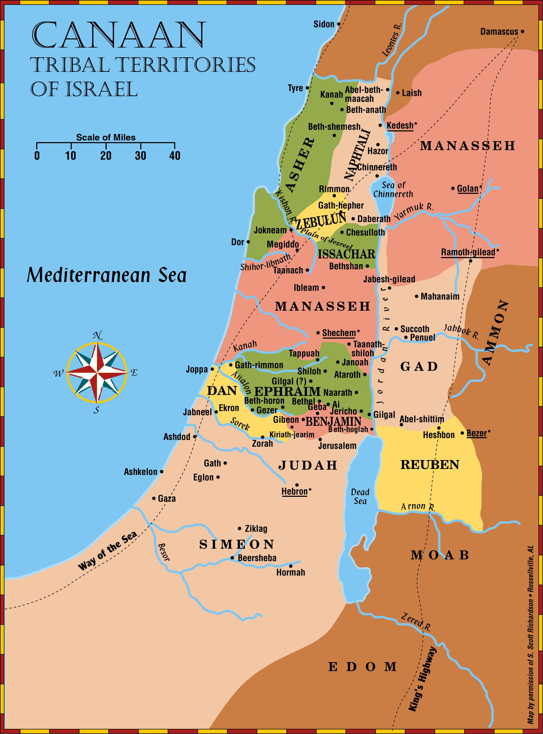
b
Bethlehem in Zebulun. Joshua 19:15
Bethlehem in Judea Micah 5:2

Slide 14
Prophecies Of Christ’s Character And Fulfillment
“Lowly” … Isaiah 42:1-4; 53:7; Zechariah 9:9; cf. Matthew 21:1-5
“I am meek and lowly in heart.” Matthew 11:29
cf. Our attitude. Philippians 2:5; 2 Corinthians 8:9

Slide 15
Prophecies Of His Ministry … And Fulfillment.
There would be a forerunner.
John the Baptist, was set forth as one “that crieth in the wilderness,” preparing “the way of the Lord.” (Isaiah 40:3-5; Matthew 3:3; cf. John 1:19ff)
The prophets said in fact and in effect, “Before the Savior comes, one will come who will tell you that He shortly will come.” (cf. Malachi 3:1; 4:5; Matthew 11:7-15; Mark 9:11-13; Luke 1:17)

Slide 16
Prophecies Of His Ministry … And Fulfillment.
Specific prophecies of His ministry.
Jesus’ service to the down trodden. Isaiah 42:5-7; Luke 4:18
His ministry to the Gentiles. Isaiah 42:1-4; Matthew 12:21
He would teach in parables. Psalms 78:2; Mark 4:33-34
God had prepared through prophecy His right to be received as “That Prophet of God.” cf. Deuteronomy 18:18

Slide 17
Prophecies Of His Betrayal, Trial
Many specific prophecies.
He was to be betrayed by a friend. Psalms 41:9; 55:13
Sold for 30 pieces of silver. Zechariah 11:12-13; Matthew 27:3-10
He would be deserted by his disciples. Zechariah 13:7; Matthew 26:56
He would be mocked and insulted. Psalms 35:15-16
He would remain silent. Isaiah 53:7; Matthew 27:12-14,39,41,43

Slide 18
Prophecies Of His Death
Many specific prophecies of His death.
His hands and feet were to be pierced. Psalms 22:16; Luke 23;33; John 21:25, 27
He was to be given vinegar and gall to drink. Psalms 69:21; Matthew 27:34
He was to die with the wicked. Isaiah 53:9; Matthew 27:38

Slide 19
Prophecies Of His Death
He was to be nailed to the cross, but no bones were to be broken. Psalms 22:16; 34:20; John 19:36; cf. Exodus 12:46; 1 Corinthians 5:7
His garments to be parted and lots cast. Psalms 22:18; John 19:24
He was to cry, “My God, My God, why hast thou forsaken me?” Psalms 22:1; Matthew 27:46
His side to be pierced. Zechariah 12:10; John 19:34, 37
To be buried in a rich man’s tomb. Isaiah 53:9; Matthew 27:57-60

Slide 20
Prophecies Of His Resurrection And Coronation
Perhaps no greater example than the application of David’s Psalm 16:8ff and Psalms 110:1 in Acts 2.
Luke 24:44-46, “And he said unto them, These are my words which I spake unto you, while I was yet with you, that all things must needs be fulfilled, which are written in the law of Moses, and the prophets, and the psalms, concerning me. Then opened he their mind, that they might understand the scriptures; and he said unto them, Thus it is written, that the Christ should suffer, and rise again from the dead the third day.”

Slide 21
Conclusion:
They could recognize Him who was to deliver them if they would but “search the Scriptures.” (John 5:39)
Paul “reasoned from the Scriptures, that Christ must needs have suffered, and risen again from the dead.” Acts 17:2, 3, 11, 12
This proves that the prophecies were designed to draw men to Jesus.
That is how the apostle used them … Acts 3:13-24; 13:23-27

Slide 22
Conclusion:
Jesus rebuked the disciples on the day of His resurrection: Luke 24:25-26, “O fools and slow of heart to believe all the prophets have spoken; Ought not Christ to have suffered these things, and to enter into His glory?”

